Slide 1
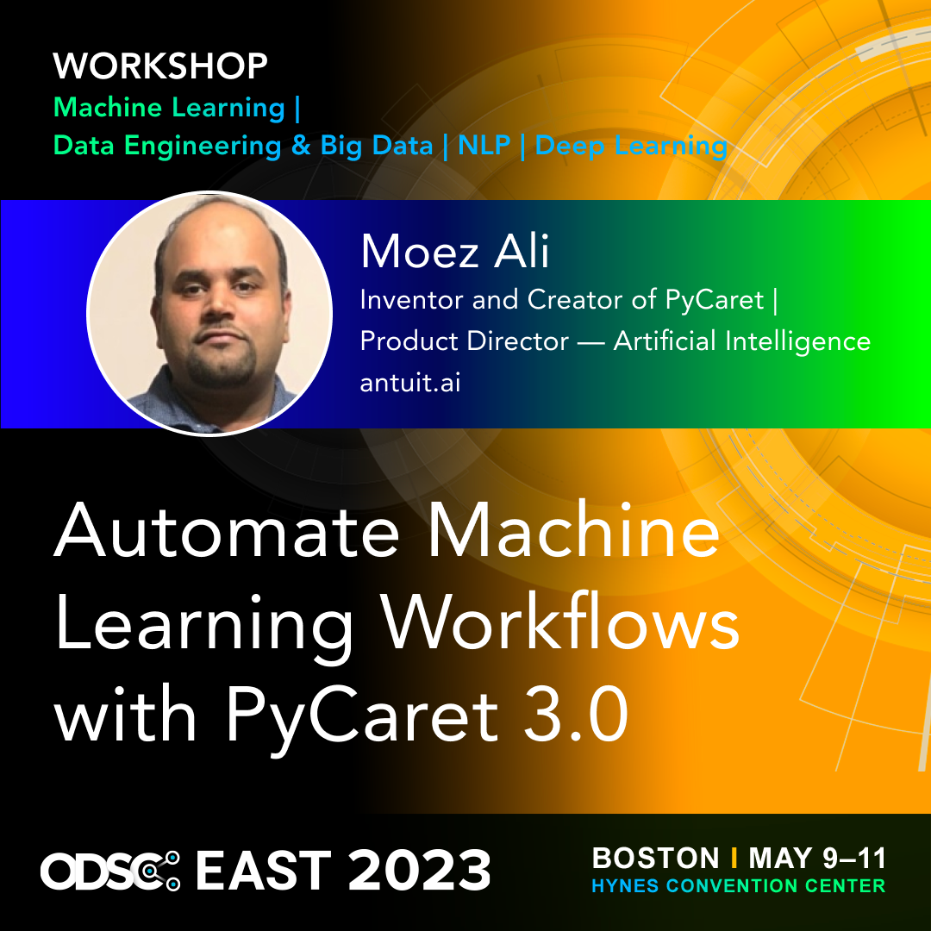

Slide 2
Demo Code
This presentation and demo is available on: https://www.github.com/pycaret/pycaret-odsc2023

Slide 3



Moez Ali
Background: Finance + Economics + Data Science
Industry: Healthcare + Education + Consulting + Fintech + Retail
Current Work: AI Product Strategy Director @ Antuit.AI
Academic / Research: Queens University, Cornell University, University of Regina
Open-source: PyCaret
Moez Ali
@moezali

Slide 4
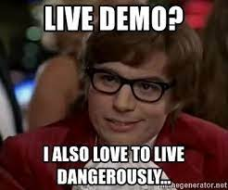
By the end of this session:
What is PyCaret
Live demo: Use-case implementation in Python

Slide 5
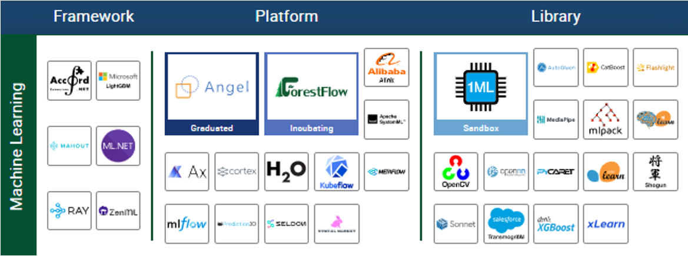
AI and Data Landscape - 2023
Source: Linux Foundation

Slide 6



PyCaret
PyCaret is an open source, low-code machine learning library for building and deploying machine learning pipelines in Python. It is commonly used for rapid prototyping and primarily targeted towards Citizen Data Scientists.
PyCaret is an open source, low-code machine learning library for building and deploying machine learning pipelines in Python. It is commonly used for rapid prototyping and primarily targeted towards Citizen Data Scientists.
EASY TO USE
PRODUCTIVITY TOOL
BUSINESS READY

Slide 7
Machine Learning Life Cycle
Deployment & Monitoring
Model Training & Selection
Deployment & Monitoring
Business Problem
Data Sourcing & ETL
Exploratory Data Analysis (EDA)
Data Prep.
Model Training & Selection
Data Prep.

Slide 8
Data Prep, Model Training and Selection
Data
Train Test Split
Train
Missing Values Imputation
Feature Scaling
Encodings
Feature Engineering
Test
Final Pipeline
Deploy
Monitor
Cross Validation Environment
Model Training
Model Tuning
Model Selection
Model Ensemble

Slide 9






Features:
Data
Preparation
Model
Training
Hyperparameter
Tuning
Analysis &
Interpretability
Model
Selection
Experiment
Logging

Slide 10
Use-cases supported in PyCaret
Classification
Regression
Time Series
SUPERVISED
Clustering
Anomaly Detection
Association Rule Mining
Natural Language Processing
UNSUPERVISED

Slide 11
PyCaret metrics
10M+
7,000+
100+
4,500+
Downloads
Git Stars
Contributors
Commits

Slide 12












Integrations

Slide 13
Demo

